Slide 1
Expectations for Cloud Ready Applications
Speaker
Day, Month Year

Slide 2
What is cloud-native all about?
This is an approach to building and operating software that takes advantage of the cloud-computing model. Often seen as a combination of microservices, continuous delivery, containers, and DevOps.
It’s all about software that’s built for scale, built for continuous change, built to tolerate failure, built for manageability.

Slide 3
Ok, but how do I know that I’m doing well at software?
Improved speed. Faster cycle time, more frequently deployments.
Improved scale. More requests per second to apps and services.
Improved stability. Greater uptime of customer-facing service.
Improved security. Achieving 100% patch coverage.
Improved simplicity. Reduce complexity of processes and tools.
Why do you need to be good at software?
Customers expects it. | Meet demand to operate at scale. | Gives you more business options. | Your competitors are doing it. | It makes everyone happier.

Slide 4
Why do you need to be good at software
Customers expects it. | Meet demand to operate at scale. | Gives you more business options. | Your competitors are doing it. | It makes everyone happier.

Slide 5
There is a maturity model to cloud native
Cloud Ready
Cloud Friendly
Cloud Resilient
Cloud Native
No File System Dependency
Self contained application
Platform managed ports/address
Consume off-platform services
Twelve factor app
Horizontal scalable
Leverage Platform for HA
Designed for failure
Apps unaffected by dependencies
Proactive failure testing
Metrics and monitoring baked in
Cloud agnostic runtime
Microservices architecture
API-first design

Slide 6
What are microservices?
It refers to an architectural style that supports constant change in your environment. This is accomplished by creating applications our of independent, loosely-coupled, domain-oriented services.
Moving to microservices? Here’s what to consider. | Do you have a pressing reason to do it?
 | Can you rearrange your teams?
 | Are you ready to decompose your monoliths?
 | How will you decompose?
 | Are you currently doing CI/CD ?
 | Is your production environment automated?
 | How will you discover services at runtime?
 | What can you do to prevent cascading failures?
 | Are you ready to evolve your data platforms?
 | Do you need to modernize your messaging and event stream processing toolchain?

Slide 7
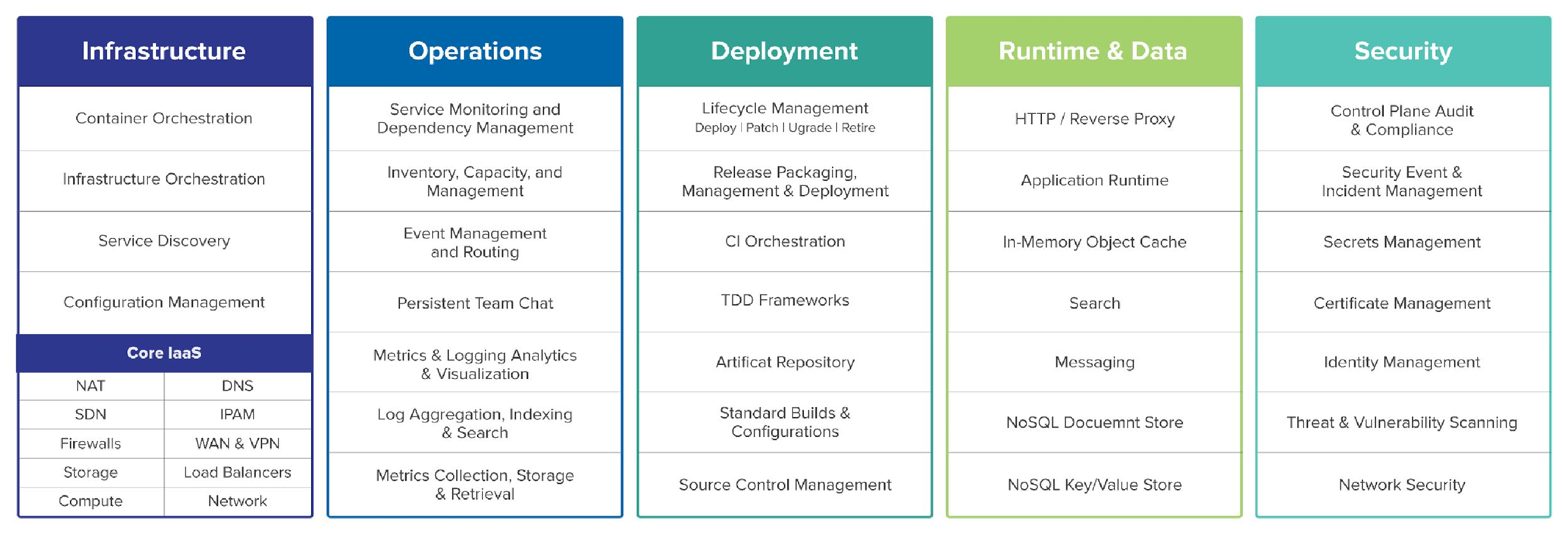
So, What actually makes up a cloud-native platform?

Slide 8
Cloud Readiness Introduction
“Cloud Readiness represents the Maturity of an organization, to identify Appropriate Cloud-services, which Generate value. Cloud-services have to be integrated efficiently and target oriented
Within enterprises in order to be able to Manage their use and allows the agile change of Cloud-Service provider”

Slide 9
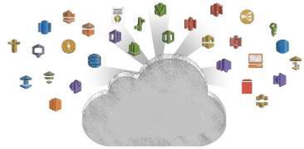

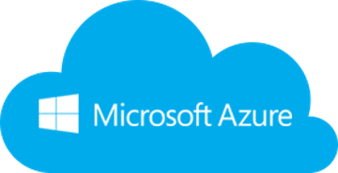
There are many reasons to move to the Cloud
Why? What? How ?
Agility
Platform Breadth
Cost Savings and Flexibility
Continual Iteration and Innovation

Slide 10
There are many reasons to move to the Cloud
Why? What? How ?
What workloads can be moved to the cloud:
Strategy & Business Goals: Applications, Processes, Data & Storage “SaaS, IaaS, PaaS”
What are the business priorities?
What technology is the business using?
What are the usage requirements?
What is the budget?

Slide 11
There are many reasons to move to the Cloud
Why? What? How?
What you’ll need in this journey

Slide 12
Healthcare Cloud Platforms
Objectives
OSFI Kubernetes
OSFI Openshift Origin
OSFI Openshift Enterprise
Azure Public
BDPaaS?

Slide 13
Health Care Cloud Overview
Speaker Name

Slide 15
Health Care Cloud | Enterprise Cloud Strategy
Enabling teams to deliver value safely, quickly and sustainably in the Healthcare Cloud. Providing for an orderly adoption of Healthcare Cloud services with visibility into who is utilizing, what is being used, how much we are spending, and what risks we are being exposed to.
Internal Business Partners
Internal Technical Partners
UHG- Enterprise
External Clients
Vendors
Offering Choices with flexibility & Agility in the offerings and bundling of those offerings.
Lowest cost option regardless of platform.
No vendor lock-in.
Ease to scale and agility to chose when.
Education and strategy considerations.
End to end audit and compliance traceability.
Agile & proactive approach to development of modules.
Solutions pre-assembled via business portfolio (i.e. Data analytics).
Provide a library of reusable modules.
Inner-Source/ Coaching/Training materials& opportunities.
Security Framework with no interruption to application or services.
Delivering Value at the lowest risk to the business.
Meetings Compliance & Security Policies.
Monitoring/ remediation/ reporting on risk.
Offering out services priced to break-even.
Multiple Vendor Options to meet various business needs across the organization.
Multi-channel/market approach consolidates investment in common platforms/ services & capabilities.
Product interoperability existing CSP security and compliance.
Cost Savings by leveraging power in numbers.
IaaS/PaaS strategy.
Help vendor maximize cost/value proposition
New Vendor Service models:
Micro-service injections
Blended data/code ownership
New life cycles
Partners

Slide 16

Health Care Cloud | Team Maturity Expectations
Level 0
Level 1
Level 2
Level 3
Level 4
Level 5
Source code management
using Git, EGH and Pull Requests
Partially automated test/build process (CI) (e.g. Jenkins)
Fully automated test/build process (CI) (e.g. Sonar)
Partially automated deployment process (CD)
Logging/Monitoring in place across all env’s (e.g. Ruxit)
Service based (API-centric) design leveraging containers
IAC in place as part of the CI/CD pipeline (e.g. Chef)
Serverless UI/Single Page Web App (SPA)
API calls routed through public cloud edge networks or using cloud based DNS configuration
Reality: teams are not at the expected maturity level needed to move to the cloud. Expectation: Only teams/apps at Level 5 consider migrating to Public Cloud with confidence.
Data and API/Service/ Business Logic tiers migrated to public cloud platform

Slide 17



Health Care Cloud | Who moves to the Public Cloud?
Application Categories
Even if a team demonstrates readiness for the public cloud, it does not entitle them to deploy to the public cloud.
Teams must demonstrate a use case for the Public Cloud offerings based upon one or more of the following criteria:
Commerciality: The application or service is intended for external commercial uses. Commercial applications, or apps that are used externally that have the potential for “viral” user uncertainty, are good candidates for public cloud (with proper scaling).
Volatility: Applications that have very high load peaks compared to its average, also known as seasonality of the workload. We need to manage the volatility on the public cloud to ensure we do not impact other services and reduce cost if planning for the worse case.
Data Gravity: Big data is difficult, costly and time consuming to move back and forth between data centers. Application requiring a large amount of data should be hosted close to the data.
Integration Gravity: Applications that are deployed to public cloud should not have multiple dependencies on integrations located in the Optum data center. Integration should only be through streaming methods or API.
User Gravity: If the users are all in the UHG network (and if the data is all in the data center), then the application should be hosted in the Optum Data Center.
PII/PHI: The presence of PII/PHI is a factor used when evaluating workload placement, but it is not the only criteria. The volatility of the workload and data gravity has more weight when making workload placement. Additionally, the controls in place assume the presence of PII/PHI and the controls are mandatory.

Slide 18

Cloud | Private Cloud Journey Team Experience
Dev. Team Cloud Journey
Crawl
Walk
Run
Marathon
Cloud Aligned
Portfolio/Application on Cloud Readiness
Team Maturity Assessment
Revise Architecture- Modernized
Leverage Training Materials
Engage Sprint 0 team
Cloud Enabled
Cont’d Training/ Coaching
Onboard to Non-Prod
Finalize Target Architecture
POC /Pilot
Cloud Ready
Immutable Containers
CI/CD & gitops
Decouple the data
Design for scaling
Observability
Cross Cloud
Multi-cluster deployment
True devops
Serverless if applicable
Mature operation
Self-healing application
Advanced data management
0-1 month 1-3 months 3-6 Months 6-8 Months

Slide 19
Cloud | Public Cloud Journey Team Experience
Dev. Team Cloud Journey
Crawl
Walk
Run
Marathon
Cloud Aligned
Portfolio/Application on Cloud Readiness
Team Maturity Assessment
Revise Architecture- Modernized
Leverage Training Materials/ Workshops/ Redbox
Engage Coaching Team
Cloud Enabled
Cont’d Training/ Coaching
Develop in Redbox
Finalize Target Architecture
Leverage Automated Modules
POC Ready
Cloud Ready
Immutable Infrastructure
IAC/ EAC
CI/CD
API Calls
Cross Cloud
Use Self-Service CSP selection based on Client Needs/Price
Zero Trust Networking is Realized
Serverless is Common practice
Machine Learning Applied to Operations
2-4 months. 4-6 months. 6-9 Months TBD

Slide 20
Cloud Ready Applications
Speaker Name

Slide 21
Health Care Cloud | What is Cloud Readiness?

Slide 22
Health Care Cloud | Cloud Readiness Vs Cloud Native

Slide 23
12 Factor Application
Speaker Name

Slide 24
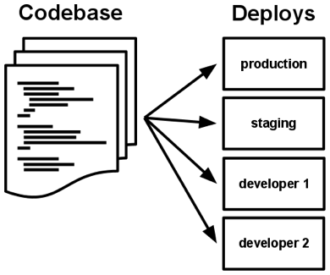
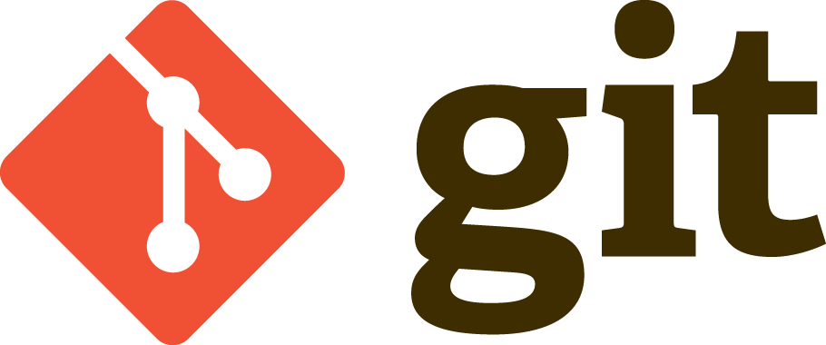
#1 Codebase
One Codebase should be used to track all changes to the application
Git
Subversion
Each Codebase can have numerous different deploys for all of the environments needed
Prod Deploy
Non Prod Deploy
Stage Deploy

Slide 25
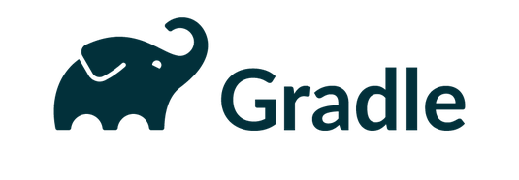

#2 Dependencies
Dependencies should be explicitly declared and isolated
Handled by common tools such as gradle or maven
Eliminates Dependency on system-level tools or libraries.
Notes:
https://github.optum.com/EAIP/meme-http/blob/master/build.gradle#L45

Slide 26
#3 Config
Configurations should be stored within environment variables
Within Kubernetes this can be done via your deployment yaml or through configmaps
Be cautious of storing a password in environment variables as if the container or runtime is compromised these passwords can be accessed
Better to mount a secret volume and point at the password directory within Kubernetes
Notes:
https://github.optum.com/OPTUMSource/blank/blob/master/web/src/main/resources/application.yml
https://github.optum.com/DataExternalization/eligibility-api-consumer/blob/master/src/main/resources/application.yml#L143 and https://github.optum.com/DataExternalization/eligibility-api-consumer/blob/master/osedeploy.yaml#L92

Slide 27
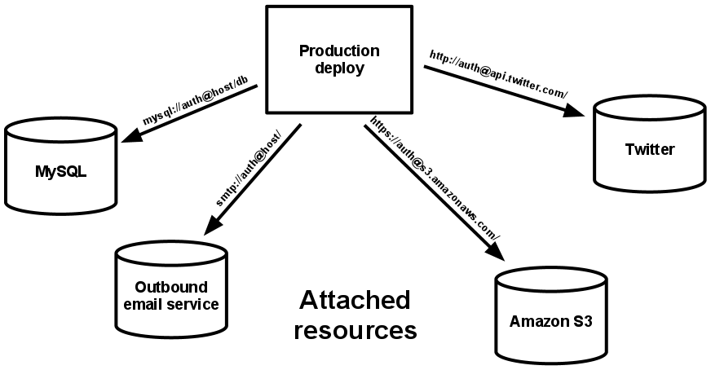
#4 Backing Services
Think of backed databases, caches, etc as attached resources.
Code should be agnostic of the backed
Easily switch between different types of databases with no code change

Slide 28
#5 Build, Release, Run
Build – Code that has been compiled and has all of the needed dependencies downloaded by the dependency manager
Release – A release combines the built code with the current deployments configuration. A package that is
Run – An app running in an execution environment that is comprised of numerous processes

Slide 29
#6 Processes
Execute the app as one or more stateless processes
Any data that needs to be persisted should use a persistent data backend
Avoid using sticky sessions at all costs. Session data should be stored in a datastore such as Redis or Memchaced

Slide 30
#7 Port Binding
Each Application should be bound to a specific port so that it can be easily accessed by other applications
Should not rely on a runtime injection of a webserver
An exception to this would be a consumer that pulls and pushes data but does not expose anything itself
If one app is a backing service for another app the details on this port can be stored within the config.
Within Kubernetes you can rely on internal DNS Names to map to the containers IP and Port
Notes:
https://github.optum.com/DataExternalization/eligibility-api-consumer/blob/master/osedeploy.yaml#L245

Slide 31
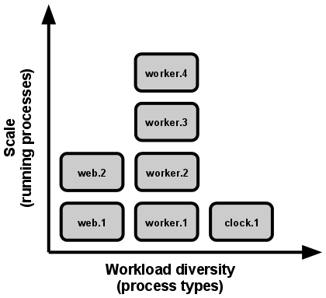
#8 Concurrency
Each type of workload should be handled by creating a new process
In order to achieve concurrency duplicate processes can be spun up and load can be split across them.
Container Orchestration Engines Handle a lot of this for you (Kubernetes, Openshift)
Notes:
https://github.optum.com/DataExternalization/eligibility-api-consumer/blob/master/osedeploy.yaml#L33

Slide 32
#9 Disposability
Applications need to be able to be torn down and restarted quickly
In a containerized world containers can move to a different physical node at any point
SIGTERM can be utilized when a graceful shutdown happens
A queue can be used for crash events where events are placed back in the queue in the event of a timeout
Notes:
https://github.optum.com/gist/aaronkorver/3f130bb388766ee95441f09a70e0f82b

Slide 33
#10 Dev/prod parity
Time Gap – Within hours or minutes after a developer writes code it should be deployed to production
Personnel Gap – A developer who writes code should be involved during the deployment and also monitor the applications behavior
Tools Gap – Tools used in a development environment should be identical to those used in production. In a containerized world this is very possible. Eliminates many one of issues that arise
Notes:
https://github.optum.com/gist/aaronkorver/3f130bb388766ee95441f09a70e0f82b

Slide 34
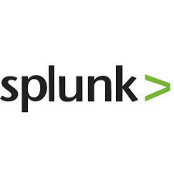


#11 Logs
Logs should be an event stream
Send them to stdout and stderr for aggregation
Have a collector running such as Fluentd or Filebeat that ships the logging over to an analytics tool such as Splunk or Elasticsearch

Slide 35
#12 Admin Processes
Run admin/management tasks as one-off processes
Keep admin tasks in source control and packaged alongside the application to ensure it is run in the same environment as the application.

Slide 36
Data Centric Applications in Cloud
Speaker Name

Slide 37
Data Centric Applications in Cloud
Initially Figured Data Services Would be Further Down the Road
Storage and networking bandwidth requirements made data services prohibitively slow in cloud environments
Some advantages to applications don’t apply to data products (e.g. horizontal scalability, etc.)
Software not designed to run under container orchestration systems
However
Storage and networking infrastructure have made amazing strides recently
Open source communities are creating Kubernetes compatible versions of software
Cloud Advantages for Data Stores and Analytics Workloads
Leveraging elastic compute resources for exploratory and periodic analytics work loads
Dynamically provision test environments
Usage based chargeback models
Flexibility, Scalability, et.
Given advancements in infrastructure and stateful software we’re pushing ahead with offering data services within OSFI

Slide 38


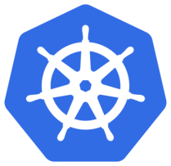

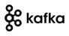












Data Centric Applications - Strategy
Data Scientists
Developers
Data Engineers
Data Analysts
OSFI
BDPaaS
Member
Provider
Big Data Tools
ML / DL Tools
Data Services
Bring-Your-Own
Claims
Clinical
Data Catalog
Traditional Big Data Tools
Elastic Compute – Self-service, multi-tenant
YARN – Multi-tenant
Flexible Storage – HDFS with S3, Volume Plugins
Big Data Storage - MapRFS
Compute
RAM
CPUs
GPUs
Storage
NAS/FLASH
SSD/HDD
Availability Zones – Optum Data Centers
On-Premises DC

Slide 39




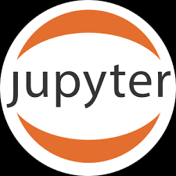
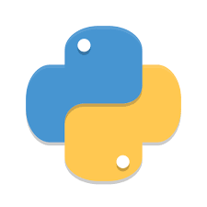
How to Run Data Centric Tools in OSFI
Reusable and customizable Big Data tools will be published and managed in Optum Helm Chart repo
Master
Worker
HDFS with S3
MapRFS / BDPaaS
ISCSI Block Storage - Flash
NFS NAS/Flash
Optum Object-Store
Worker
Clone Optum Chart repo
Customize Charts
Create and test build pipeline
Deploy applications
Manage versions
LLAP
Applications
Big Data Store

